Slide 1
Mathematics
Session 7: Fractions with Letters
Haarlem
Peter Stikker
Notes:
Slides created by P. Stikker.
Version: 16 July 2019

Slide 2
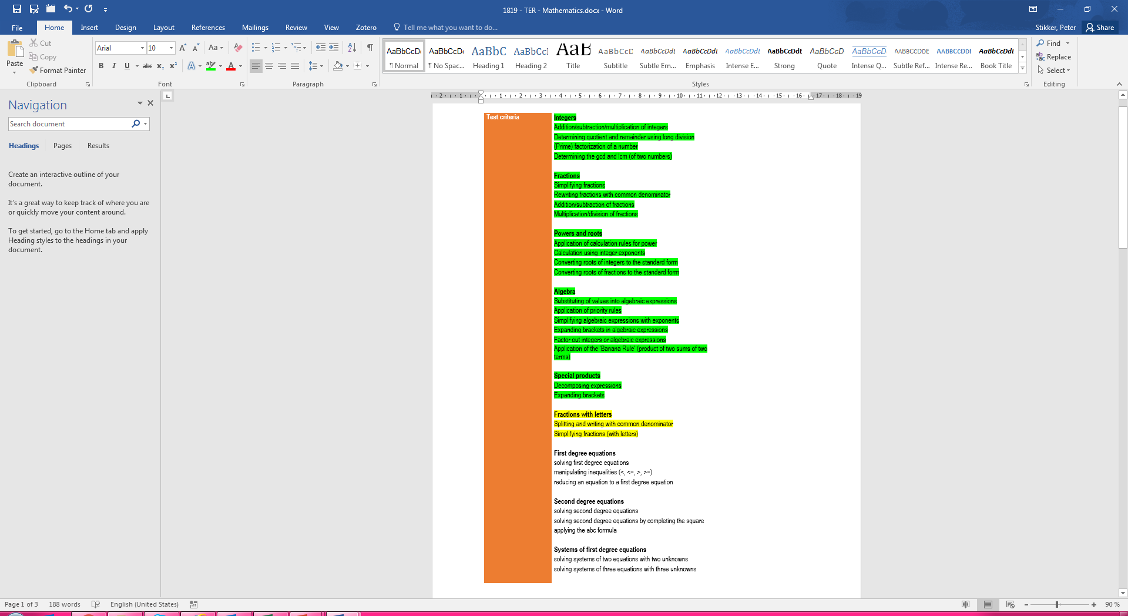
Today
Splitting a fraction
Common denominator
Simplify fraction (with letters)

Slide 3
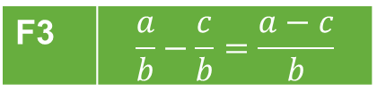




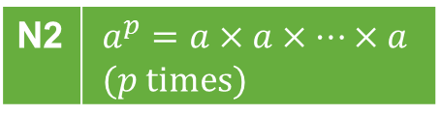

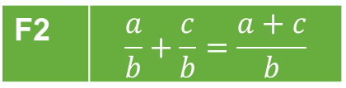
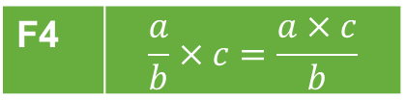

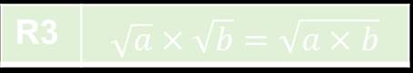











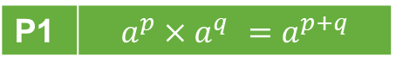

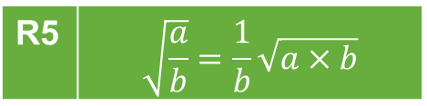




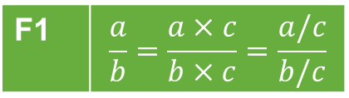
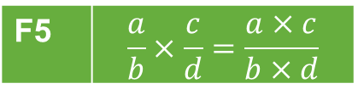
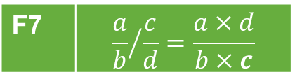

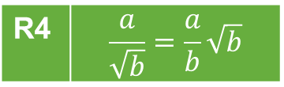


Overview so far…
Power rules
Fraction rules
Notation rules
P1 | $$a^{p}×a^{q} =a^{p+q}$$
F1 | $$\frac{a}{b}=\frac{a×c}{b×c}=\frac{a/c}{b/c}$$
F5 | $$\frac{a}{b}×\frac{c}{d}=\frac{a×c}{b×d}$$
N1 | $$\frac{a}{b}=a/b=a:b$$
P2 | $$a^{p}:a^{q}=a^{p−q}$$
F2 | $$\frac{a}{b}+\frac{c}{b}=\frac{a+c}{b}$$
F6 | $${\frac{a}{b}}/c=\frac{a}{b×c}$$
N2 | $$a^{p}=a×a×…×a \\ (p \text{times})$$
P3 | $${\left(a^{p}\right)}^{q} =a^{p×q}$$
P4 | $${\left(a×b\right)}^{p}=a^{p}×b^{p}$$
F3 | $$\frac{a}{b}−\frac{c}{b}=\frac{a−c}{b}$$
F7 | $${\frac{a}{b}}/{\frac{c}{d}}=\frac{a×d}{b×c}$$
N3 | $$a^{1}=a$$
P5 | $${\left(\frac{a}{b}\right)}^{p}=\frac{a^{p}}{b^{p}}$$
N4 | $$a×b=a∙b=ab$$
F4 | $$\frac{a}{b}×c=\frac{a×c}{b}$$
N5 | $$\sqrt{a}=\sqrt[2]{a}$$
P6 | $$a^{−p}=\frac{1}{a^{p}}$$
Basic rules
Root rules
Brackets rules
B1 | $$\frac{a}{1}=a$$
R1 | $$\sqrt{a^{2}}=a$$
R1 | $$\sqrt[n]{a^{n}}=a$$
Br1 | $$a\left(b+c\right)=ab+ac$$
R2 | $${\left(\sqrt[n]{a}\right)}^{n}=a$$
B2 | $$\frac{a}{a}=1$$
R2 | $${\left(\sqrt{a}\right)}^{2}=a$$
Br2 | $$\left(a+b\right)\left(c+d\right)=ac+ad+bc+bd$$
R3 | $$\sqrt[n]{a}×\sqrt[n]{b}=\sqrt[n]{a×b}$$
R3 | $$\sqrt{a}×\sqrt{b}=\sqrt{a×b}$$
Br3 | $${\left(a+b\right)}^{2}=a^{2}+2ab+b^{2}$$
B3 | $$a×1=a$$
R4 | $$\frac{a}{\sqrt{b}}=\frac{a}{b}\sqrt{b}$$
Br4 | $${\left(a−b\right)}^{2}=a^{2}−2ab+b^{2}$$
B4 | $$a×b=b×a$$
B5 | $$a+b=b+a$$
R5 | $$\sqrt{\frac{a}{b}}=\frac{1}{b}\sqrt{a×b}$$
Br5 | $$\left(a+b\right)\left(a−b\right)=a^{2}−b^{2}$$

Slide 4
Algorithms
Algorithms
A1: Prime factorization
A2: Divisors
A3: GCD
A4: LCM
A5: Simplify fraction
A6: LCD
A7: Simplify square root
A8: Common Denominator
A9: Simplify fraction with Letters

Slide 5
Segment 1
Splitting a fraction

Slide 6
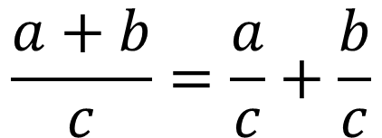
Splitting a fraction
Splitting a fraction means: changing one single fraction into multiple fractions (with common denominator)
$$\frac{a+b}{c}=\frac{a}{c}+\frac{b}{c}$$

Slide 7
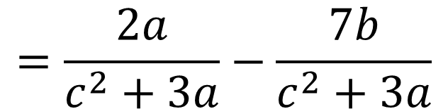
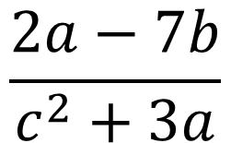
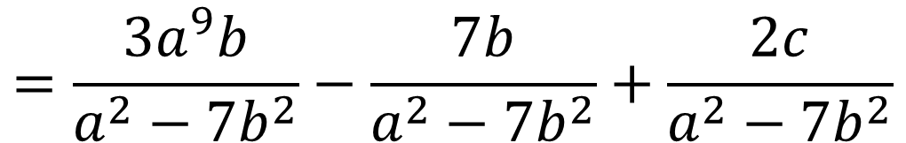
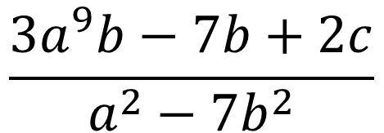
Splitting a fraction
Yes, that is all there is to it. Two more examples
$$\frac{2a−7b}{c^{2}+3a}$$
$$=\frac{2a}{c^{2}+3a}−\frac{7b}{c^{2}+3a}$$
$$\frac{3a^{9}b−7b+2c}{a^{2}−7b^{2}}$$
$$=\frac{3a^{9}b}{a^{2}−7b^{2}}−\frac{7b}{a^{2}−7b^{2}}+\frac{2c}{a^{2}−7b^{2}}$$

Slide 8
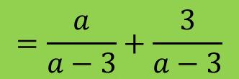
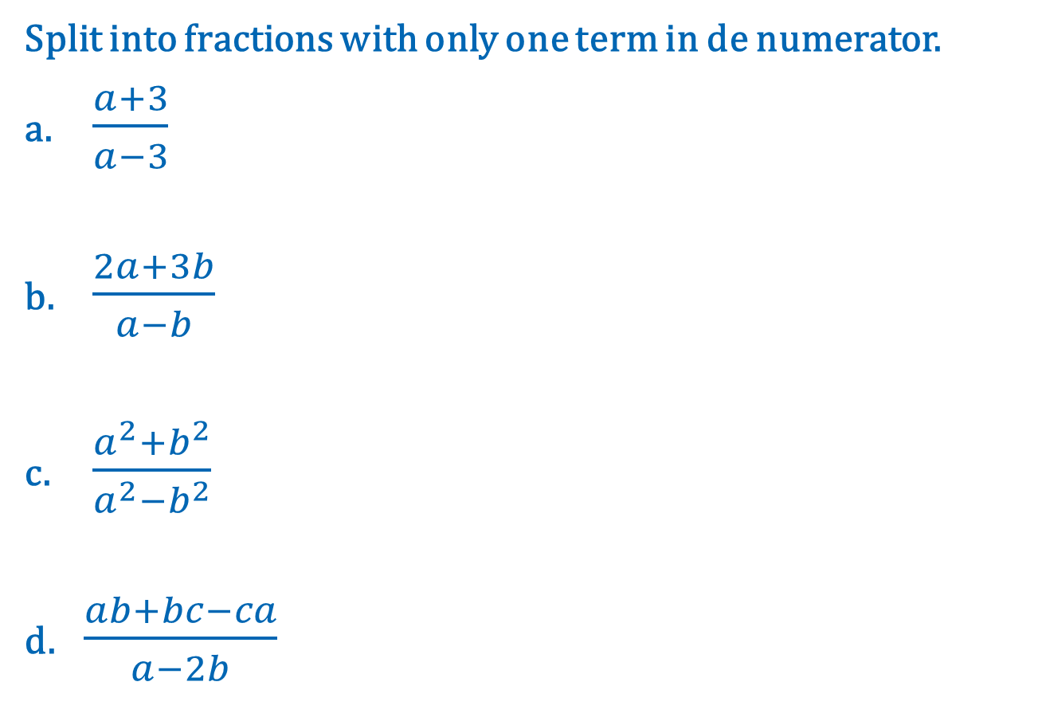
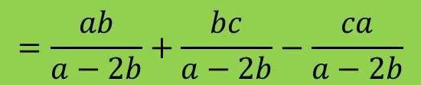
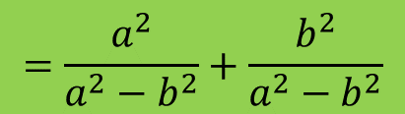
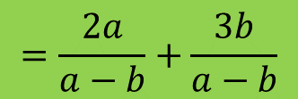
Practice 1
Split into fractions with only one term in de numerator.
a. $\frac{a+3}{a−3}$
b. $\frac{2a+3b}{a−b}$
c. $\frac{a^{2}+b^{2}}{a^{2}−b^{2}}$
d. $\frac{ab+bc−ca}{a−2b}$
$$=\frac{a}{a−3}+\frac{3}{a−3}$$
$$=\frac{2a}{a−b}+\frac{3b}{a−b}$$
$$=\frac{a^{2}}{a^{2}−b^{2}}+\frac{b^{2}}{a^{2}−b^{2}}$$
$$=\frac{ab}{a−2b}+\frac{bc}{a−2b}−\frac{ca}{a−2b}$$

Slide 9
Segment 2
Common denominator (revisited)

Slide 10
Why again?
In session 3 we discussed adding and subtracting fractions with numbers.
To add or subtract fractions the denominator has to be the same.
To write fractions with a common denominator, we used the LCM.
Unfortunately we cannot determine the LCM if we have letters instead of numbers ☹

Slide 11
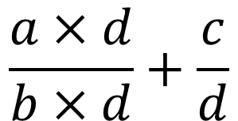
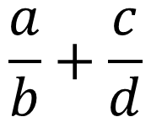
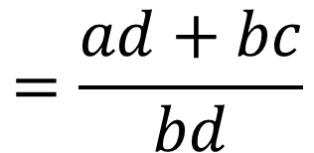
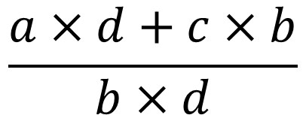
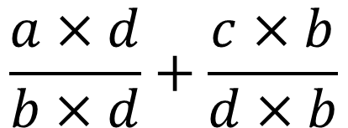
adding and subtracting fractions with letters
Example
$$\frac{a}{b}+\frac{c}{d}$$
Algorithm to write fraction with common denominator:
Multiply numerator and denominator of the first fraction, with the denominator of the second.
Multiply numerator and denominator of the second fraction, with the denominator of the first.
After the two fractions are written with a common denominator, add or subtract them (depending on the exercise)
$$\frac{a×d}{b×d}+\frac{c}{d}$$
$$\frac{a×d}{b×d}+\frac{c×b}{d×b}$$
$$\frac{a×d+c×b}{b×d}$$
$$=\frac{ad+bc}{bd}$$

Slide 12
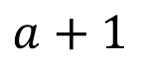
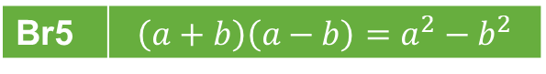
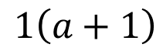
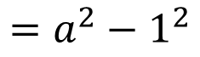
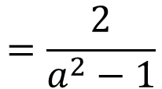
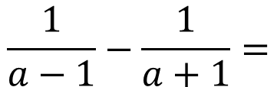
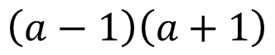
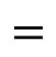
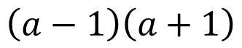
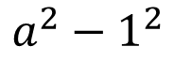
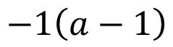
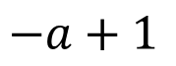
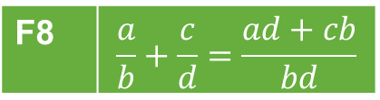
Example 1
F8 | $$\frac{a}{b}+\frac{c}{d}=\frac{ad+cb}{bd}$$
$$\frac{1}{a−1}−\frac{1}{a+1}=$$
$$1\left(a+1\right)$$
$$−1\left(a−1\right)$$
$$a+1$$
$$−a+1$$
$$=\frac{2}{a^{2}−1}$$
$$=$$
$$\left(a−1\right)\left(a+1\right)$$
$$a^{2}−1^{2}$$
Br5 | $$\left(a+b\right)\left(a−b\right)=a^{2}−b^{2}$$
$$\left(a−1\right)\left(a+1\right)$$
$$=a^{2}−1^{2}$$

Slide 13
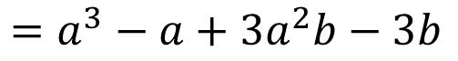
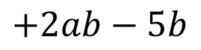
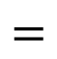
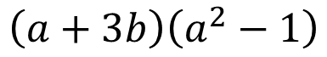

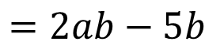
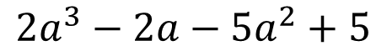
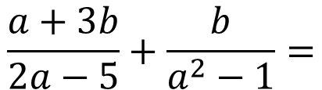
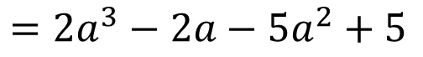
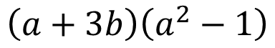

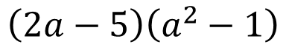






Example 2
F8 | $$\frac{a}{b}+\frac{c}{d}=\frac{ad+cb}{bd}$$
$$\frac{a+3b}{2a−5}+\frac{b}{a^{2}−1}=$$
$$\left(a+3b\right)\left(a^{2}−1\right)$$
$$+\left(2a−5\right)b$$
$$a^{3}−a+3a^{2}b−3b$$
$$+2ab−5b$$
$$=$$
$$\left(2a−5\right)\left(a^{2}−1\right)$$
$$2a^{3}−2a−5a^{2}+5$$
$$=\frac{a^{3}−a+3a^{2}b+2ab−8b}{2a^{3}−2a−5a^{2}+5 }$$
Br2 | $$\left(a+b\right)\left(c+d\right)=ac+ad+bc+bd$$
$$\left(a+3b\right)\left(a^{2}−1\right)$$
$$=a^{3}−a+3a^{2}b−3b$$
Br1 | $$a\left(b+c\right)=ab+ac$$
$$\left(2a−5\right)b$$
$$=2ab−5b$$
Br2 | $$\left(a+b\right)\left(c+d\right)=ac+ad+bc+bd$$
$$\left(2a−5\right)\left(a^{2}−1\right)$$
$$=2a^{3}−2a−5a^{2}+5$$

Slide 14














Practice 2
a. $\frac{1}{a−3}−\frac{1}{a+3}$
b. $\frac{1}{a−3}+\frac{a}{a+3}$
c. $\frac{a+1}{a−2}−\frac{a−1}{a+3}$
d. $\frac{3a−5}{a−1}+\frac{2a+3}{a−2}$
$$=\frac{1\left(a+3\right)−1\left(a−3\right)}{\left(a−3\right)\left(a+3\right) }$$
$$=\frac{a+3−a+3}{a^{2}−3^{2}}$$
$$=\frac{6}{a^{2}−9}$$
$$=\frac{1\left(a+3\right)+a\left(a−3\right)}{\left(a−3\right)\left(a+3\right) }$$
$$=\frac{a+3+a^{2}−3a}{a^{2}−3^{2}}$$
$$=\frac{3+a^{2}−2a}{a^{2}−9}$$
$$=\frac{\left(a+1\right)\left(a+3\right)−\left(a−1\right)\left(a−2\right)}{\left(a−2\right)\left(a+3\right) }$$
$$=\frac{a^{2}+3a+1a+3−\left(a^{2}−2a−a+2\right)}{a^{2}+3a−2a−6}$$
$$=\frac{a^{2}+3a+1a+3−a^{2}+2a+a−2}{a^{2}+3a−2a−6}$$
$$=\frac{7a+1}{a^{2}+a−6}$$
$$=\frac{\left(3a−5\right)\left(a−2\right)+\left(2a+3\right)\left(a−1\right)}{\left(a−1\right)\left(a−2\right) }$$
$$=\frac{3a^{2}−6a−5a+10+2a^{2}−2a+3a−3}{a^{2}−2a−a+2}$$
$$=\frac{5a^{2}−10a+7}{a^{2}−3a+2}$$

Slide 15
Segment 3
Simplify fraction with letters

Slide 16







Simplify fractions with letters
Example
Algorithm:
Factor out as much as possible in the numerator and denominator:
check common factors in terms, and
check if any special product is present
Substitute common factors in numerator and denominator by 1.
Simplify and work out brackets.
$$\frac{3a^{3}−12a}{a−2}$$
$$=\frac{3a×a^{2}−3a×4}{a−2}$$
$$=\frac{3a\left(a^{2}−4\right)}{a−2}$$
$$=\frac{3a\left(a+2\right)\left(a−2\right)}{a−2}$$
$$=\frac{3a\left(a+2\right)×1}{1}$$
$$=3a\left(a+2\right)×1$$
$$=3a^{2}+6a$$

Slide 17












Examples
$$\frac{3a+9b^{2}}{6a−3}$$
$$=\frac{3\left(a+3b^{2}\right)}{3\left(2a−1\right)}$$
$$=\frac{1×\left(a+3b^{2}\right)}{1×\left(2a−1\right)}$$
$$=\frac{a+3b^{2}}{2a−1}$$
$$\frac{7b}{b+2b^{3}}$$
$$=\frac{7b}{b\left(1+2b^{2}\right)}$$
$$=\frac{7×1}{1×\left(1+2b^{2}\right)}$$
$$=\frac{7}{1+2b^{2}}$$
$$\frac{a^{2}−b^{2}}{a+b}$$
$$=\frac{\left(a+b\right)\left(a−b\right)}{a+b}$$
$$=\frac{1×\left(a−b\right)}{1}$$
$$=a−b$$

Slide 18



















Practice 3 & 4
3) Simplify the following fractions as much as possible.
a. $\frac{3a+18}{9b−6}$
b. $\frac{a^{2}+a}{a+1}$
c. $\frac{a^{2}b+{ab}^{2}}{3abc}$
d. $\frac{a^{2}−4a}{a+2a^{2}}$
4) Write with a common denominator and simplify the result.
a. $\frac{1}{a−3}−\frac{1}{a^{2}−9}$
b. $\frac{a^{2}+1}{a−3}−\frac{a^{2}−1}{a+3}$
$$=\frac{3\left(a+6\right)}{3\left(3b−2\right) }$$
$$=\frac{a+6}{3b−2}$$
$$=\frac{1}{a−3}−\frac{1}{\left(a−3\right)\left(a+3\right)}$$
$$=\frac{a\left(a+1\right)}{a+1 }$$
$$=\frac{1×\left(a+3\right)}{\left(a−3\right)\left(a+3\right)}−\frac{1}{\left(a−3\right)\left(a+3\right)}$$
$$=\frac{a+3−1}{\left(a−3\right)\left(a+3\right)}$$
$$=\frac{a+2}{a^{2}−9}$$
$$=a$$
$$=\frac{ab\left(a+b\right)}{3abc}$$
$$=\frac{a+b}{3c}$$
$$=\frac{\left(a^{2}+1\right)\left(a+3\right)−\left(a^{2}−1\right)\left(a−3\right)}{\left(a−3\right)\left(a+3\right)}$$
$$=\frac{a\left(a−4\right)}{a\left(1+2a\right)}$$
$$=\frac{a−4}{1+2a}$$
$$=\frac{\left(a^{3}+3a^{2}+a+3\right)−\left(a^{3}−3a^{2}−a+3\right)}{\left(a−3\right)\left(a+3\right)}$$
$$=\frac{a^{3}+3a^{2}+a+3−a^{3}+3a^{2}+a−3}{\left(a−3\right)\left(a+3\right)}$$
$$=\frac{6a^{2}+2a}{\left(a−3\right)\left(a+3\right)}$$
$$=\frac{6a^{2}+2a}{a^{2}−9}$$

Slide 19
Closure
Overview & H☺mew☹rk

Slide 20

Overview so far…
Power rules
Fraction rules
Notation rules
P1 | $$a^{p}×a^{q} =a^{p+q}$$
F1 | $$\frac{a}{b}=\frac{a×c}{b×c}=\frac{a/c}{b/c}$$
F5 | $$\frac{a}{b}×\frac{c}{d}=\frac{a×c}{b×d}$$
N1 | $$\frac{a}{b}=a/b=a:b$$
P2 | $$a^{p}:a^{q}=a^{p−q}$$
F2 | $$\frac{a}{b}+\frac{c}{b}=\frac{a+c}{b}$$
F6 | $${\frac{a}{b}}/c=\frac{a}{b×c}$$
N2 | $$a^{p}=a×a×…×a \\ (p \text{times})$$
P3 | $${\left(a^{p}\right)}^{q} =a^{p×q}$$
P4 | $${\left(a×b\right)}^{p}=a^{p}×b^{p}$$
F3 | $$\frac{a}{b}−\frac{c}{b}=\frac{a−c}{b}$$
F7 | $${\frac{a}{b}}/{\frac{c}{d}}=\frac{a×d}{b×c}$$
N3 | $$a^{1}=a$$
P5 | $${\left(\frac{a}{b}\right)}^{p}=\frac{a^{p}}{b^{p}}$$
N4 | $$a×b=a∙b=ab$$
F4 | $$\frac{a}{b}×c=\frac{a×c}{b}$$
F8 | $$\frac{a}{b}+\frac{c}{d}=\frac{ad+cb}{bd}$$
N5 | $$\sqrt{a}=\sqrt[2]{a}$$
P6 | $$a^{−p}=\frac{1}{a^{p}}$$
Basic rules
Root rules
Brackets rules
B1 | $$\frac{a}{1}=a$$
R1 | $$\sqrt{a^{2}}=a$$
R1 | $$\sqrt[n]{a^{n}}=a$$
Br1 | $$a\left(b+c\right)=ab+ac$$
R2 | $${\left(\sqrt[n]{a}\right)}^{n}=a$$
B2 | $$\frac{a}{a}=1$$
R2 | $${\left(\sqrt{a}\right)}^{2}=a$$
Br2 | $$\left(a+b\right)\left(c+d\right)=ac+ad+bc+bd$$
R3 | $$\sqrt[n]{a}×\sqrt[n]{b}=\sqrt[n]{a×b}$$
R3 | $$\sqrt{a}×\sqrt{b}=\sqrt{a×b}$$
Br3 | $${\left(a+b\right)}^{2}=a^{2}+2ab+b^{2}$$
B3 | $$a×1=a$$
R4 | $$\frac{a}{\sqrt{b}}=\frac{a}{b}\sqrt{b}$$
Br4 | $${\left(a−b\right)}^{2}=a^{2}−2ab+b^{2}$$
B4 | $$a×b=b×a$$
B5 | $$a+b=b+a$$
R5 | $$\sqrt{\frac{a}{b}}=\frac{1}{b}\sqrt{a×b}$$
Br5 | $$\left(a+b\right)\left(a−b\right)=a^{2}−b^{2}$$

Slide 21

H☺me W☹rk
Theory: Chapter 6, pages 46-49
Selected exercises: pg. 46) 6.1 6.2 6.3 6.4 6.5
pg. 48) 6.7 6.8 6.9

